Slide 2
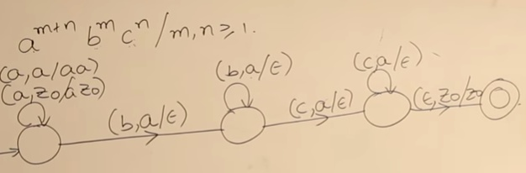
Construct a PDA for

Slide 3
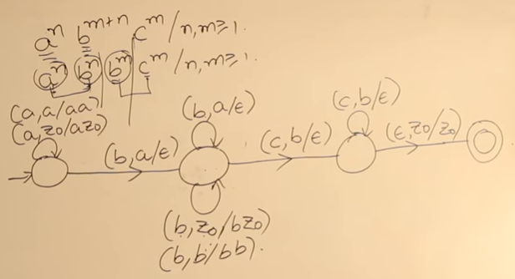
Construct a PDA for

Slide 5
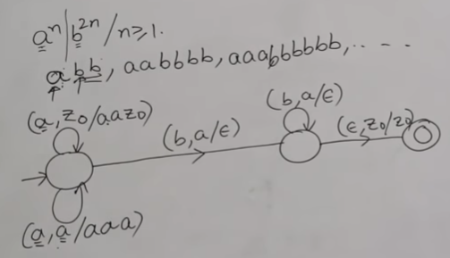
Construct a PDA for

Slide 6
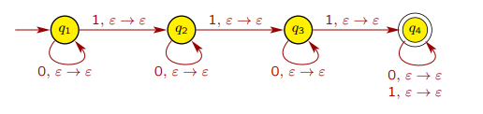
Design a PDA for at least 3 1s

Slide 7
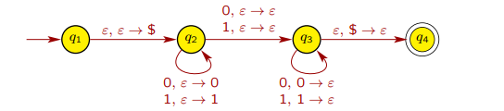
PDA for odd length Palindromes

Slide 8
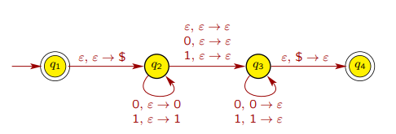
PDA for palindromes

Slide 9
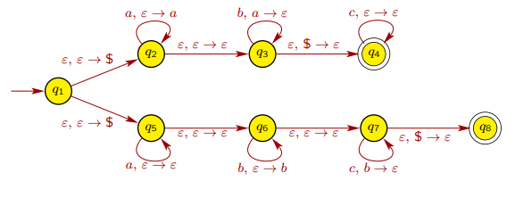
D = { a^{i} b^{j} c^{k} | i, j, k ≥ 0, and i = j or j = k }

Slide 10
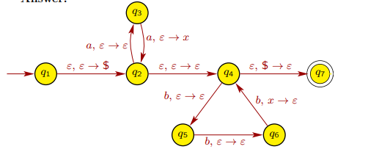
F = { a^{2n} b^{3n} | n ≥ 0 }

